Slide 1
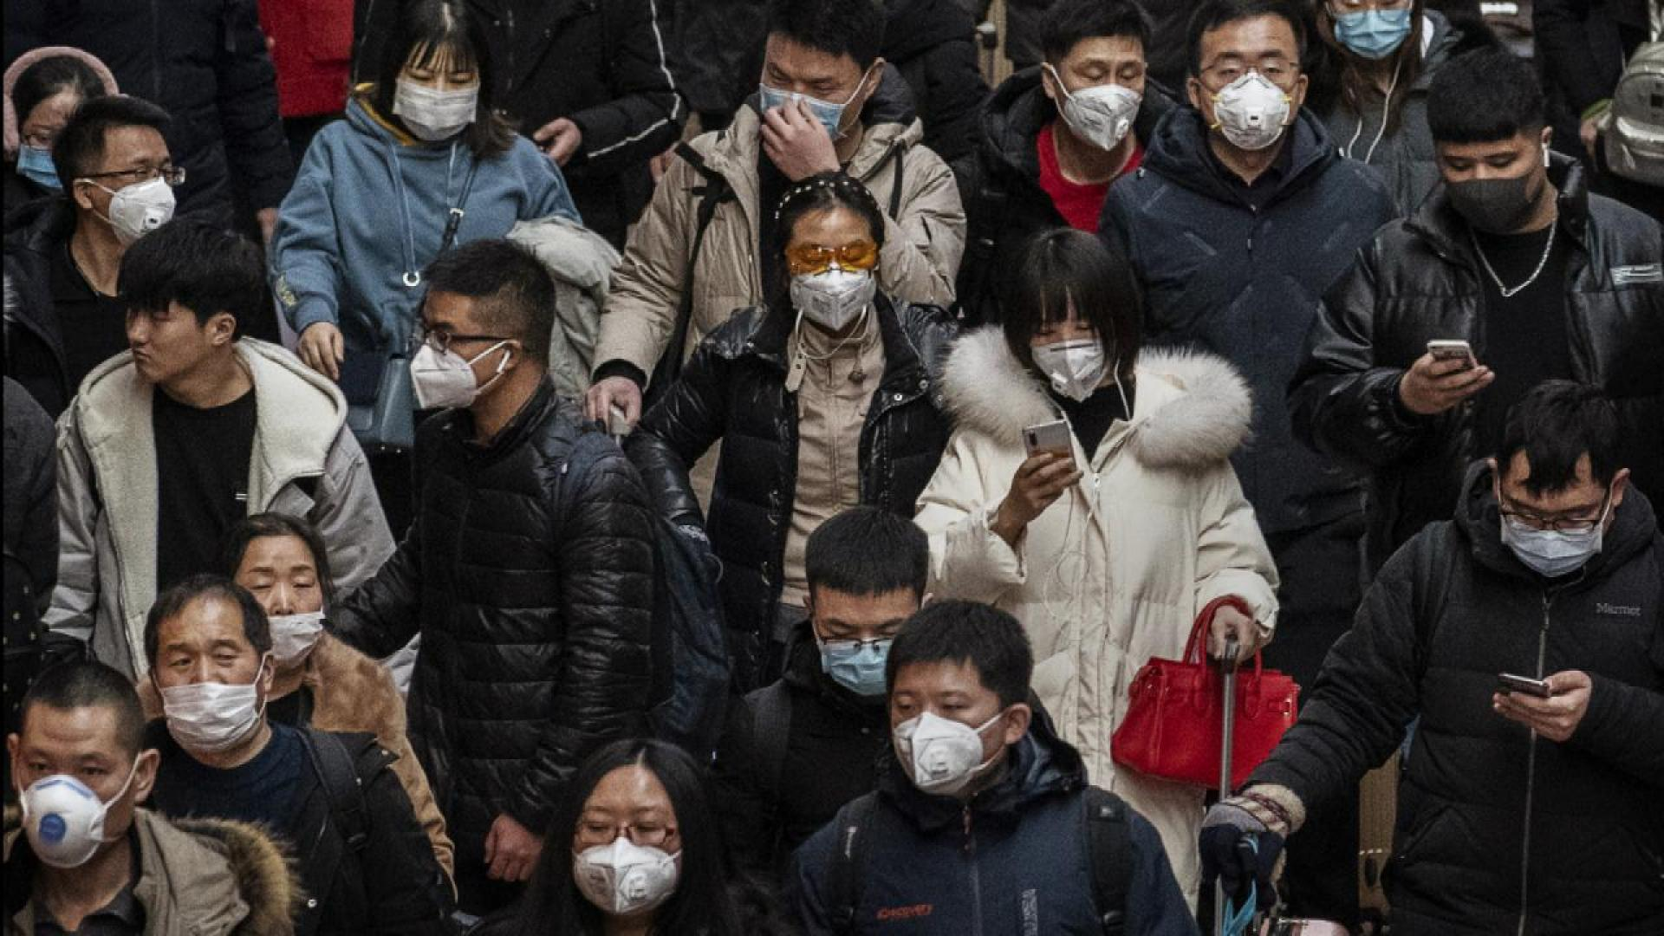
SANDEEP G
Face Mask Detection Using ML
3/21/2024 Annual Review

Slide 2
Face Mask Detection Using ML
Face Mask Detection Using ML is an innovative solution leveraging machine learning technology to automatically identify whether individuals are wearing face masks in images. With a focus on public health and safety, this project offers an efficient tool for organizations and establishments to enforce face mask policies.
By providing real-time detection capabilities, it contributes to efforts aimed at maintaining health standards and ensuring compliance with face mask guidelines, promoting a safer environment for all
3/21/2024 Annual Review

Slide 3


AGENDA
PROJECT TITLE
AGENDA
PROBLEM STATEMENT
PROJECT OVERVIEW
WHO ARE THE END USER
YOUR SOLUTION AND VALUE PROPOSITION
THE WOW IN YOUR SOLUTION
MODELLING
RESULTS
3/21/2024 Annual Review

Slide 4

PROBLEM STATEMENT
In many public settings, ensuring compliance with face mask regulations poses a significant challenge, particularly as manual monitoring methods are often resource-intensive and prone to inaccuracies. This issue becomes especially pronounced in densely populated environments where enforcing mask-wearing is crucial for public health and safety. Our project addresses this challenge by developing an automated solution using machine learning techniques to detect the presence of face masks in images. By providing a reliable and efficient method for monitoring face mask adherence, our solution aims to enhance public health measures and contribute to creating safer environments, particularly in the context of preventing the spread of infectious diseases.
3/21/2024 Annual Review

Slide 5

PROJECT OVERVIEW
Our project centers on the development of a Face Mask Detection system using machine learning technology. The objective is to create an automated solution capable of identifying whether individuals are wearing face masks in images. Despite the conclusion of the COVID-19 pandemic, the importance of face mask compliance remains relevant for various public health scenarios. Our solution aims to address the ongoing need for efficient monitoring of face mask adherence in diverse settings. By harnessing advanced machine learning algorithms, we aim to develop a system that can accurately detect the presence or absence of face masks in real-time, thereby facilitating compliance with health and safety protocols and contributing to community well-being.
3/21/2024 Annual Review

Slide 6

WHO ARE THE END USERS?
Businesses
Schools
Public transportation authorities
Healthcare facilities
Government agencies
These stakeholders may utilize the system to:
Monitor and enforce face mask compliance among employees, students, customers, passengers, patients, and the general public.
Maintain health and safety standards in their respective environments.
Ensure adherence to face mask guidelines in public spaces.
3/21/2024 Annual Review

Slide 7

YOUR SOLUTION AND ITS VALUE PROPOSITION
Automated Detection: Utilizing advanced machine learning, our system automatically identifies face mask presence in real-time images.
Efficiency & Accuracy: Saves time and resources by reducing manual monitoring while ensuring accurate detection.
Scalable & Customizable: Adaptable to various settings and customizable to meet specific user needs.
Enhanced Compliance: Promotes adherence to health and safety protocols, contributing to a safer environment.
3/21/2024 Annual Review

Slide 8

THE WOW IN YOUR SOLUTION
Real-Time Detection: Our system provides instant detection of face mask presence in images, offering immediate feedback to users.
High Accuracy: Leveraging state-of-the-art machine learning algorithms, our system ensures precise detection of face masks, minimizing errors and false alarms.
User-Friendly Interface: Designed with usability in mind, our system offers an intuitive interface that is easy to navigate, making it accessible to users of all skill levels.
Scalability: Built to accommodate various environments and user needs, our system can scale from small businesses to large-scale public spaces without compromising performance.
Customizable Solutions: With configurable parameters and settings, our system can be tailored to suit the unique requirements of different users and applications.
3/21/2024 Annual Review
8

Slide 9
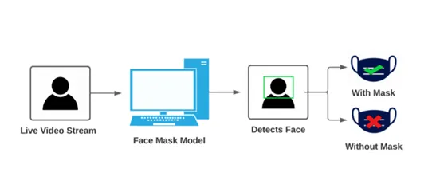
MODELLING
Wireframes
Modeling Process:
Data Collection
Preprocessing
Model Selection
Training
Evaluation
Optimization
Deployment
3/21/2024 Annual Review
9

Slide 10
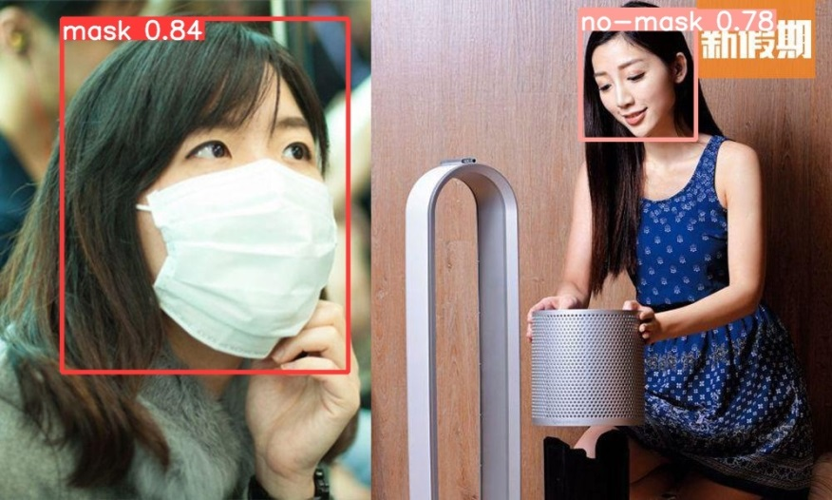
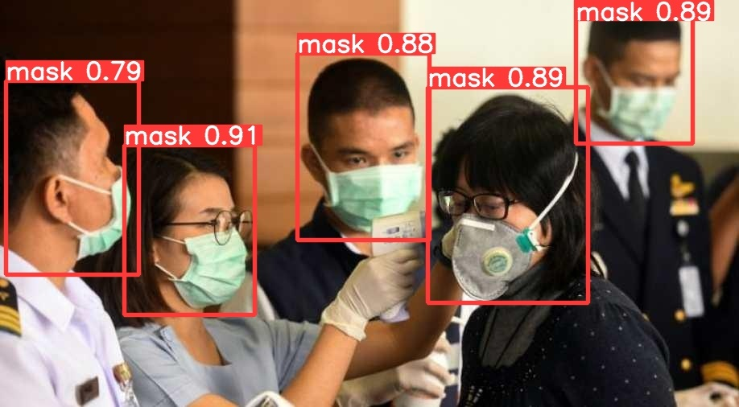
RESULTS
Output Images
Performance Metrics
Accuracy : 0.9111 or 91.11%
Precision : 0.8936 or 89.36%
Recall : 0.9333 or 93.33%
F1-score : 0.9127 or 91.27%
3/21/2024 Annual Review
10

